Slide 1

Project Title – Netflix Dataset Analysis
Student Name : Amaresh Swain
AICTE Internship ID : INTERNSHIP_17546440516895be537820f

Slide 2

💡💭 PROBLEM STATEMENT
Netflix has become one of the most prominent global streaming platforms, continuously expanding its library with a mix of original productions and licensed content. However, with growing competition from platforms like Amazon Prime, Disney+, and regional OTT providers, Netflix must strategically analyze its content catalog to identify strengths, gaps, and opportunities.
The specific problem to be addressed in this project is 'Content Trends Analysis for Strategic Recommendations'. The aim is to uncover how Netflix’s content distribution (Movies vs. TV Shows, genres, and country contributions) has evolved over the years. This will enable the identification of key genres, audience preferences, and strategic insights into global content expansion.

Slide 3
📝 Project Description
This project analyzes a Netflix dataset (7,789 records, 11 columns) to explore how the platform’s content strategy has evolved from 2008 to 2021. The dataset includes details such as title, director, cast, country, release year, rating, duration, genre, and type (Movie or TV Show).
The goal is to uncover content trends across genres, countries, and time periods to provide strategic insights for content acquisition and production.
Key steps in the project include:
🧹 Data Cleaning & Preprocessing
📊 Exploratory Data Analysis (Movies vs TV Shows, genres, country trends)
📈 Trend Detection & Visualization
💡 Strategic Recommendations
The analysis helps understand:
Evolution of Movies vs TV Shows
Popular and emerging genres
Country-wise content contributions
These insights can support data-driven decisions in the OTT industry and help platforms like Netflix stay competitive.

Slide 4

👥 WHO ARE THE END USERS?
🎬 Content Strategists & Netflix Executives
Use insights to make data-driven decisions on content acquisition and production
.
📈 Marketing & Business Teams
Identify trending genres and countries to plan targeted campaigns and audience expansion strategies.
🧠 Data Analysts & Researchers
Explore content trends, build predictive models, and support strategic planning with analytics.
🧑‍🏫 Students & Academics
Use the dataset for learning data analysis, visualization, and storytelling techniques.
🌍 OTT Industry & Competitors
Benchmark Netflix’s strategy and identify market opportunities.

Slide 5

🛠️ Technology Used
💻 Programming Language: Python 🐍
🧮 Data Analysis & Processing: Pandas, NumPy, Regular Expressions
📊 Data Visualization: Matplotlib 📈, Seaborn 🎨, Plotly 🔥
🌐 Geospatial & Mapping: GeoPandas 🗺️, Folium 🌍
🧠 Machine Learning & Statistics: Scikit-learn 🤖, Statsmodels 📐
📓 Development Environment: Jupyter Notebook 📔 / Google Colab ☁️
🗂️ Version Control & Collaboration: Git & GitHub 🧭

Slide 6
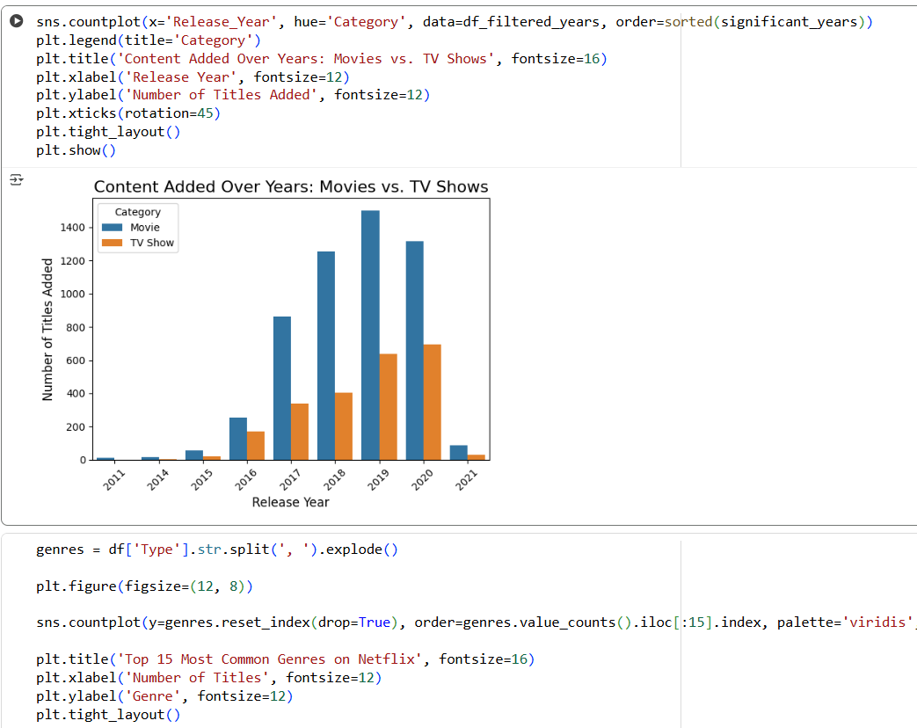
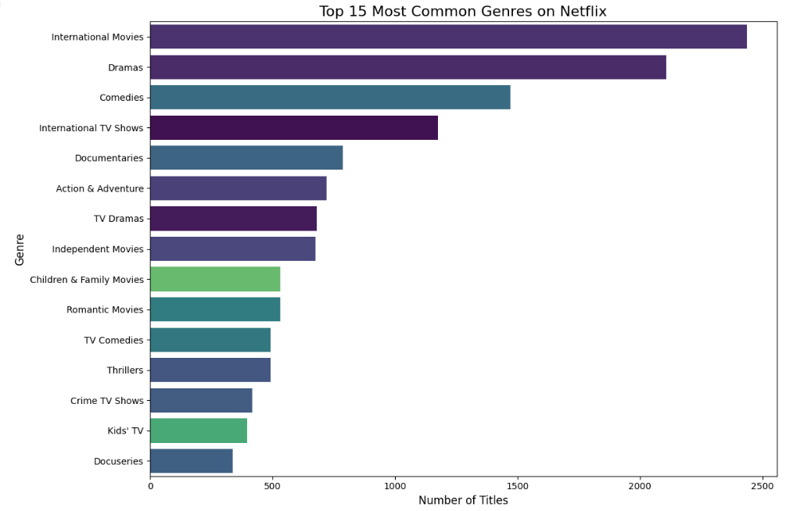
RESULTS1

Slide 7
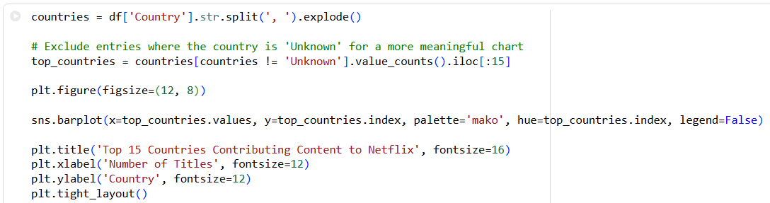
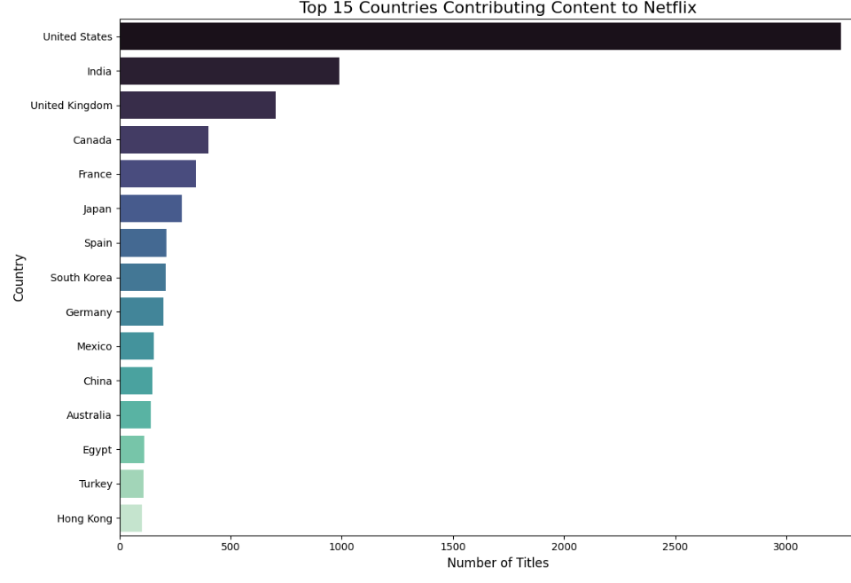
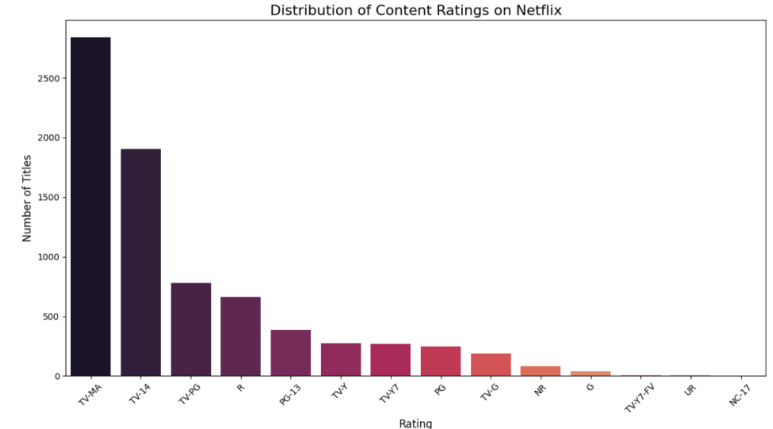
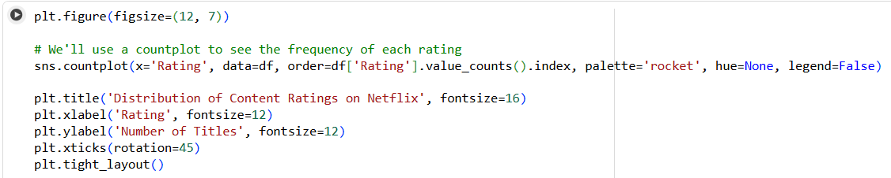
RESULTS2

Slide 8
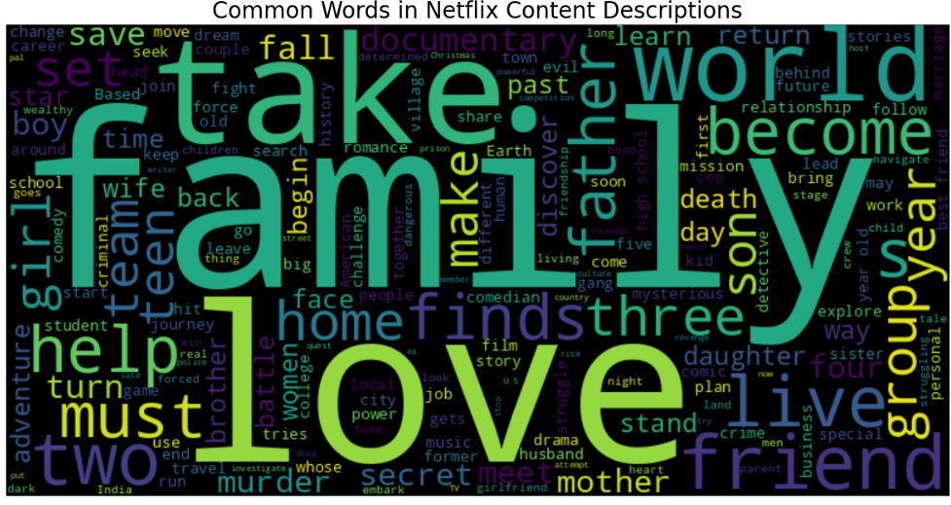
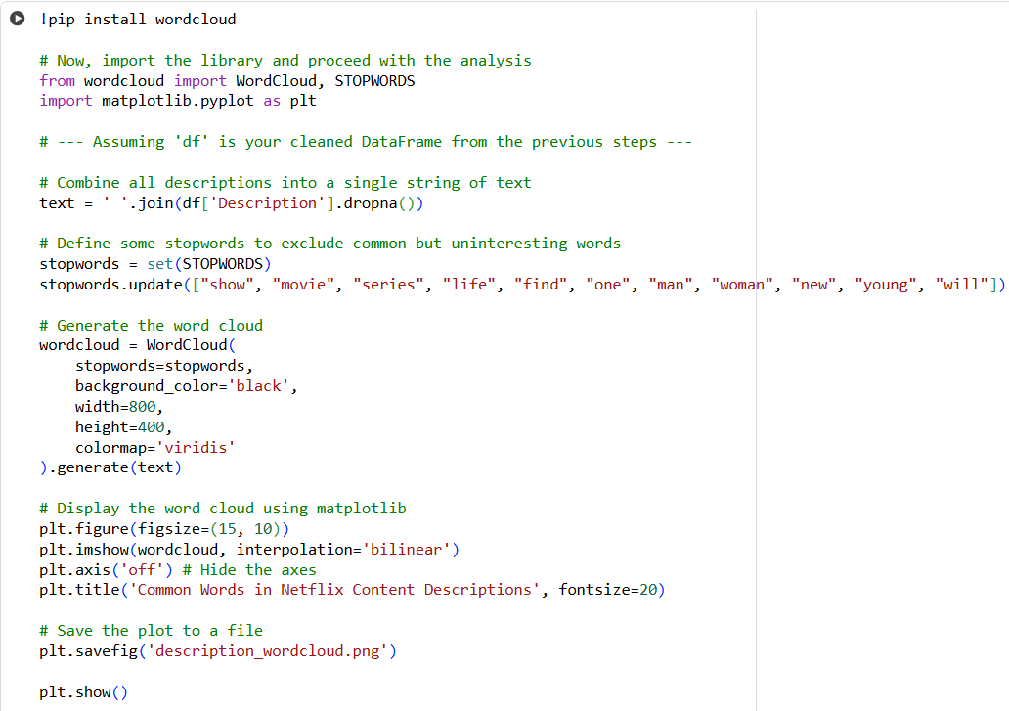
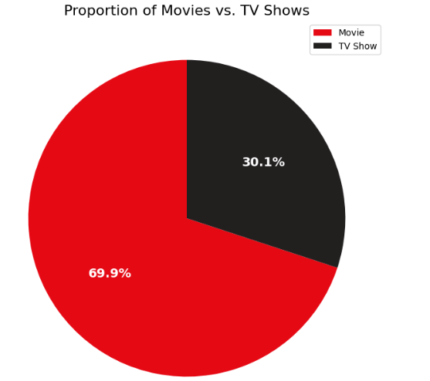
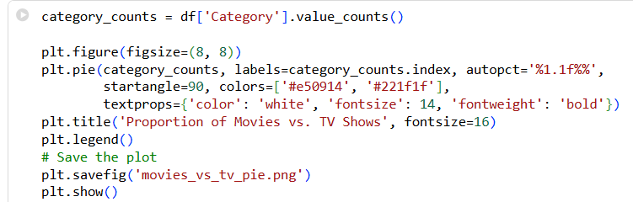
RESULTS3

Slide 9
GitHub repository
🔗 https://github.com/amr7503/VOIS_AICTE_Oct2025_MajorProject_AmareshSwain

Slide 10
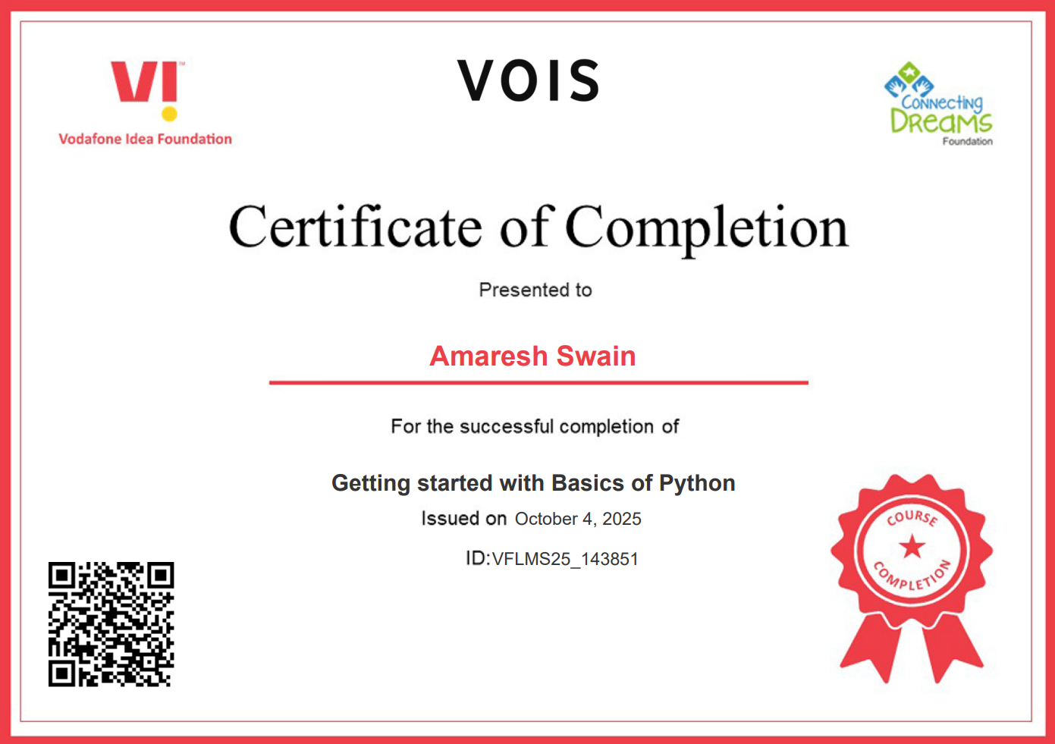
Getting started with Basics of Python Certificate

Slide 11
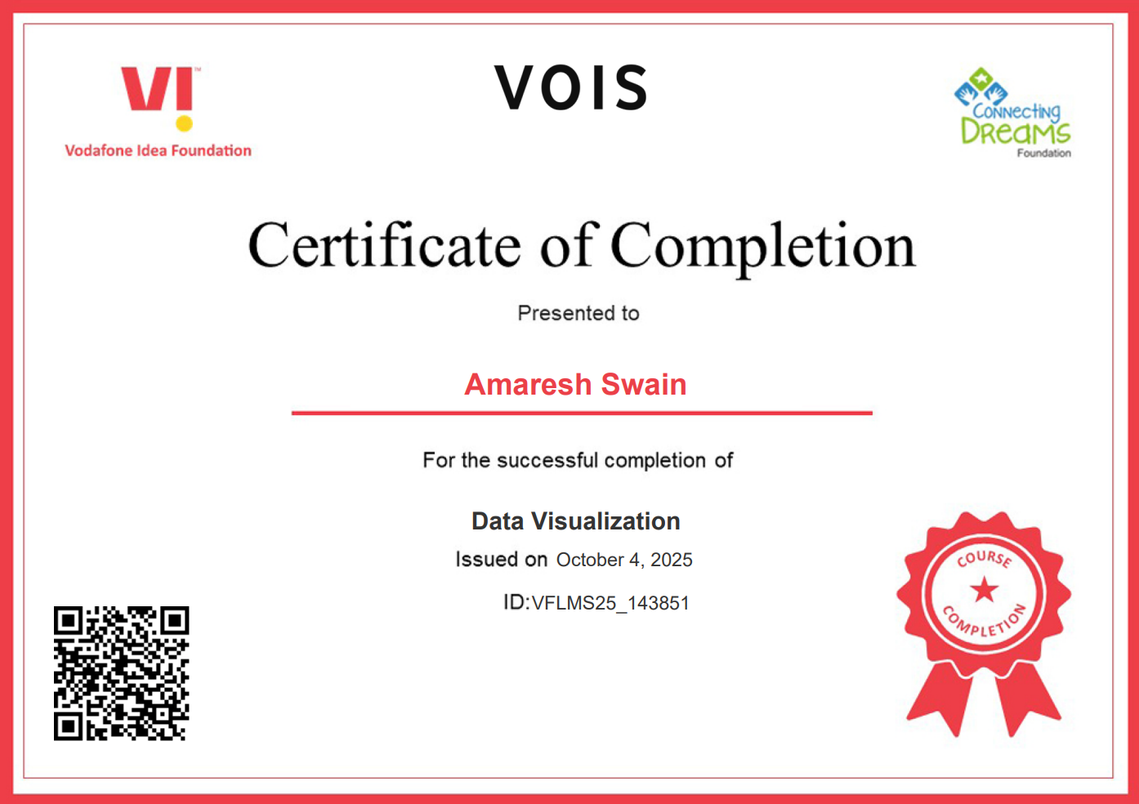
Data Visualization Certificate

Slide 12
Thank you
Presented by ~ Amaresh Swain , Siksha ‘O’ Anusandhan University , Odisha
.

